Slide 1
Boston PowerShell User Group: February
Questions:
Recorded? We’ll try. Waiting on summit session
Materials? Yep! Waiting on summit session
Wifi: BIIB-Guest / captive portal
Some handy links:
github.com/BosPSUG Materials and links
twitter.com/BosPSUG What’s coming up, DMs from anyone
Slack.PoshCode.org (Invite) PowerShell chat and #Boston channel
Huge thanks to Biogen for sponsoring the venue, SAPIEN Technologies for the food!

Slide 2
Boston PowerShell User Group: Coming Up!
March Rob Pleau Creating PowerShell Projects & more with Plaster
April Various PowerShell Summit highlights and follow-up
May Max Trinidad PowerShell Core 6
Have an idea for the meetup? Ping Steve or me!

Slide 3

Connecting the Dots with PowerShell and Neo4j
Warren Frame

Slide 4
Get-Speaker ‘Warren Frame’
Role : sysadmin
Team : FAS Research Computing
Employer : Harvard University
Twitter : @psCookieMonster
LinkedIn : /in/wframe
GitHub : RamblingCookieMonster
Projects : {PSSlack, BuildHelpers, PSDepend,
PSDeploy, Invoke-Parallel, PSNeo4j...}

Slide 5
What are we doing?

Slide 6
Why?
You might not have a CMDB
You might a $$$$ CMDB with no useful data
You might want a more flexible option than a heavy weight CMDB
You might want to take advantage of the benefits of a graph database
Having a data source with a common interface is crazy useful!
Automation, monitoring and alerting, reporting, etc. can benefit
Notes:
TODO expand, refine

Slide 7
What’s a Graph Database?
DC01
:Server
AIDBHostName : DC01
ADOperatingSystem : Windows Server 2016
Active Directory
Nodes!
Can have a label
Can have properties
:Service
Name : Active Directory
Description : Identity and related services
Notes:
“a graph database is a database that uses graph structures for semantic queries with nodes, edges and properties to represent and store data” - wikipedia

Slide 8
What’s a Graph Database?
Relationships! (Edges)
Has a Type
Directional
Can have properties
DC01
:IsPartOf
LoadBalanced : True
HighAvailablity : True
Active Directory
Notes:
“a graph database is a database that uses graph structures for semantic queries with nodes, edges and properties to represent and store data” – wikipedia
Relationships are a first class citizen
No need for associative tables

Slide 9
What’s a Graph Database?
DC01
:IsPartOf
LoadBalanced : True
HighAvailablity : True
:Server
AIDBHostName : DC01
ADOperatingSystem : Windows Server 2016
Active Directory
:Service
Name : Active Directory
Description : Identity and related services
Notes:
“a graph database is a database that uses graph structures for semantic queries with nodes, edges and properties to represent and store data” – wikipedia
Relationships are a first class citizen
No need for associative tables

Slide 10
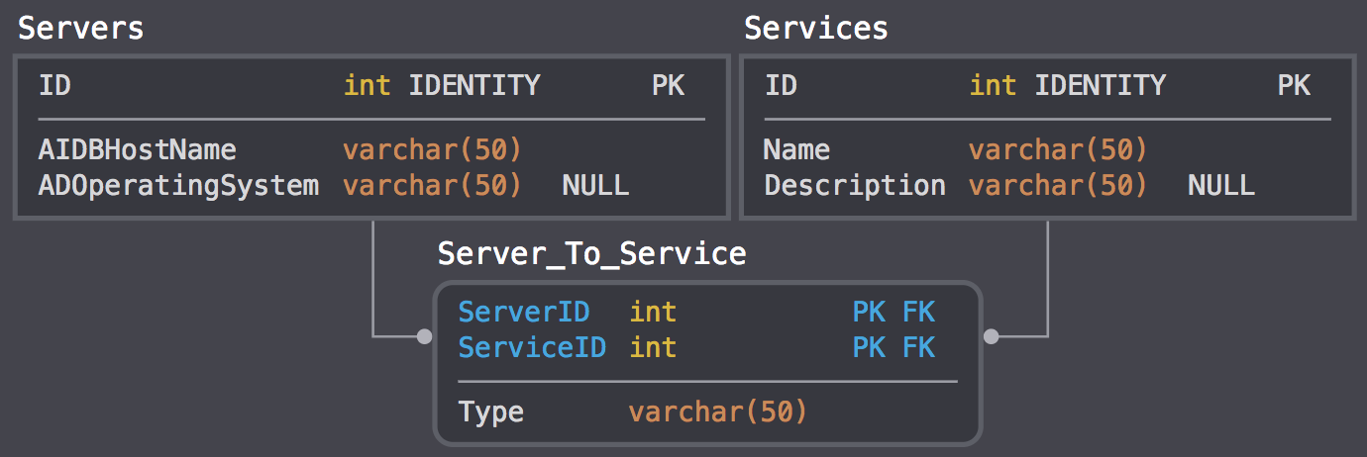
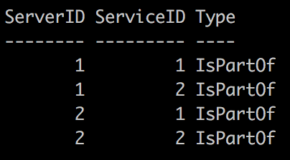
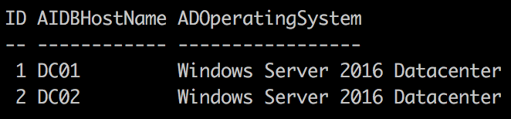
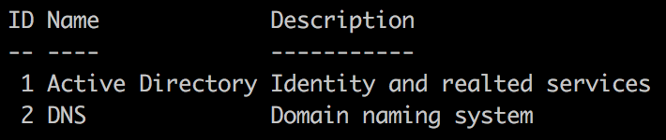
Why not a Relational Database?
Notes:
Time and complexity. Do you like dealing with these?
Associative tables
Primary key / Foreign key fun
Normalization, even if only to a reasonable extent
Complex join statements
Relationships as a second class citizen

Slide 11
Why a Graph Database?
Let’s add some recursive relationships (Service DependsOn Service)!
These many-to-many relationships would also help! (Group Uses Service)
Tell me everything that’s related in any way to this server, up to three degrees out!
Notes:
Recursive relationships and more many-to-many relationships keep building complexity in your schema and queries
Path finding difficult and far more expensive in a relational database

Slide 12
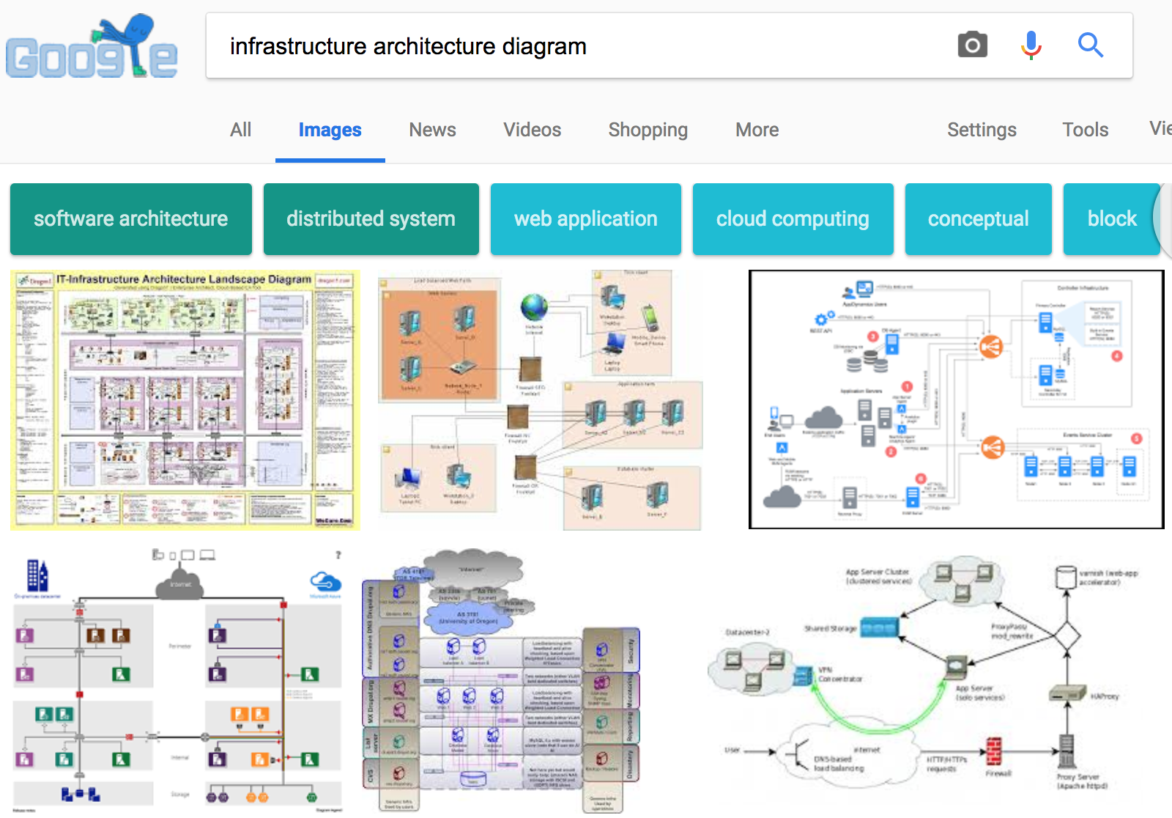
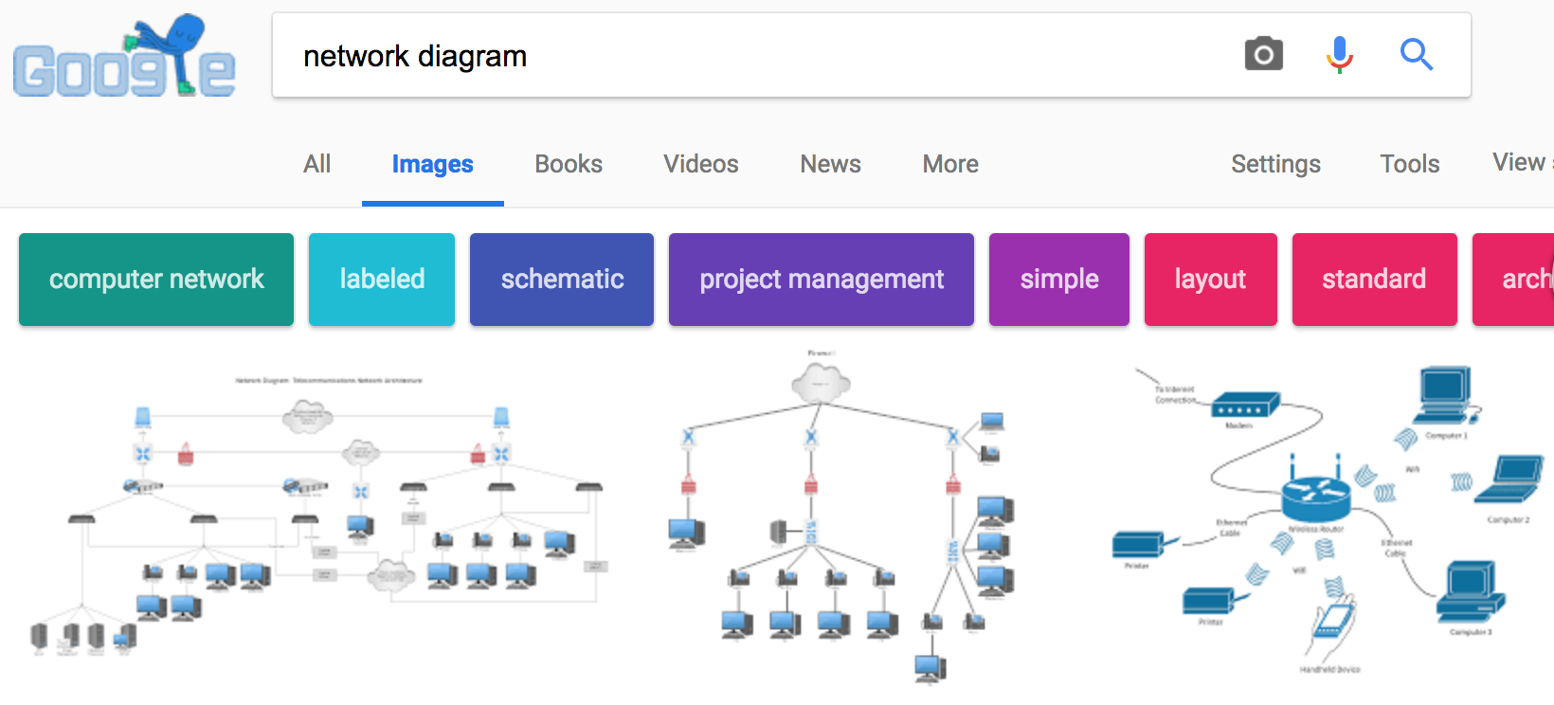
Why a Graph Database?
Notes:
When you’re illustrating a service or network, what does it look like?
Because @datachick said so: https://neo4j.com/blog/7-ways-data-is-graph/

Slide 13
Which Graph Database?
Notes:
Because…
Open source
Runs on Windows
PowerShell (and other) examples abound, community help
Just kidding – because Glenn Sarti mentioned it
Time
Examples
Community
Glenn, Rohan, Michael
https://twitter.com/mesirii
https://twitter.com/GlennSarti
https://twitter.com/CptJesus
Many others,
TODO: brief notes
ArangoDB
Titan
OrientDB
JanusGraph
Azure Cosmos DB
SQL Server 2017…
Amazon Neptune
https://github.com/BloodHoundAD/BloodHound
https://en.wikipedia.org/wiki/Hourglass#/media/File:Wooden_hourglass_3.jpg

Slide 14
Implement Neo4j
Chocolatey
Docker docker docker!
Notes:
Huge thanks to Glenn
https://glennsarti.github.io/blog/graph-all-the-powershell-things/
https://glennsarti.github.io/blog/neo4j-nano-containers

Slide 15
Questions?

Slide 16
Neo4j and PowerShell

Slide 17
Dots

Slide 18
Dots Recipe
Everything in source control
Data sources
Yaml – if Dots is the source of truth
Code – if source of truth is external
Execution
Release pipeline for yaml
Scheduled tasks or other runners for external source queries

Slide 19
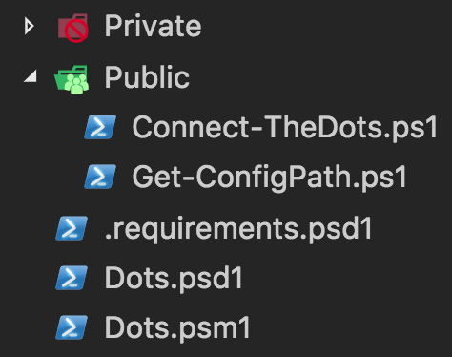
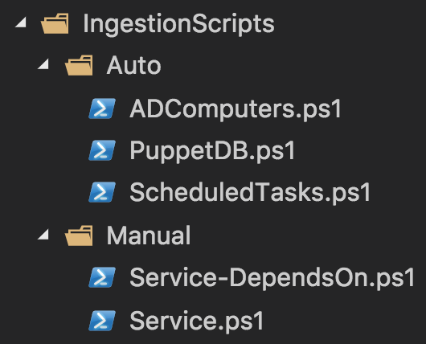
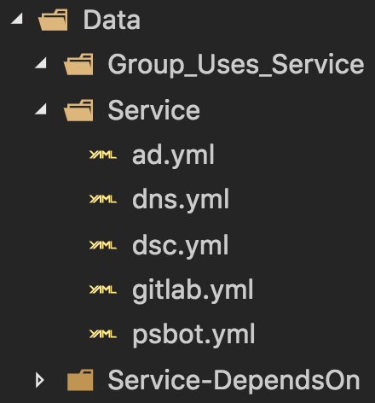
Dots – Source Control

Slide 20
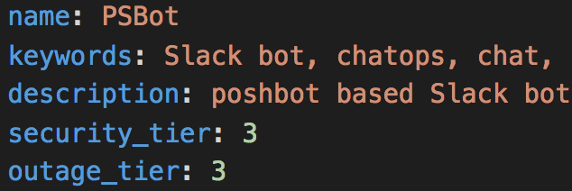
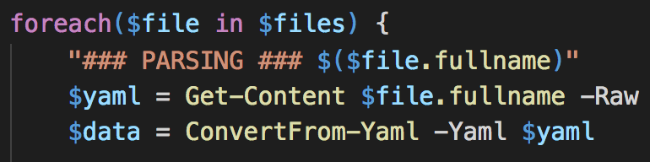
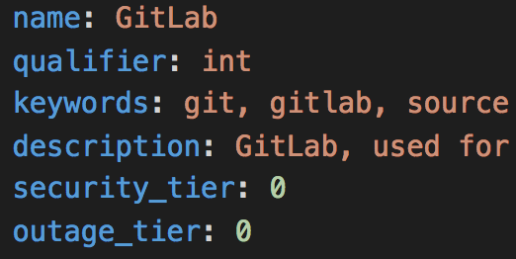
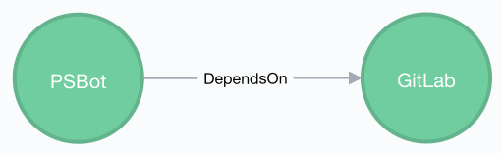
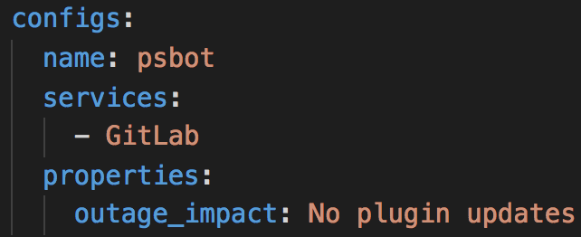
Dots: Yaml Data Sources
Yaml
Ingestor Scripts
Dots!

Slide 21
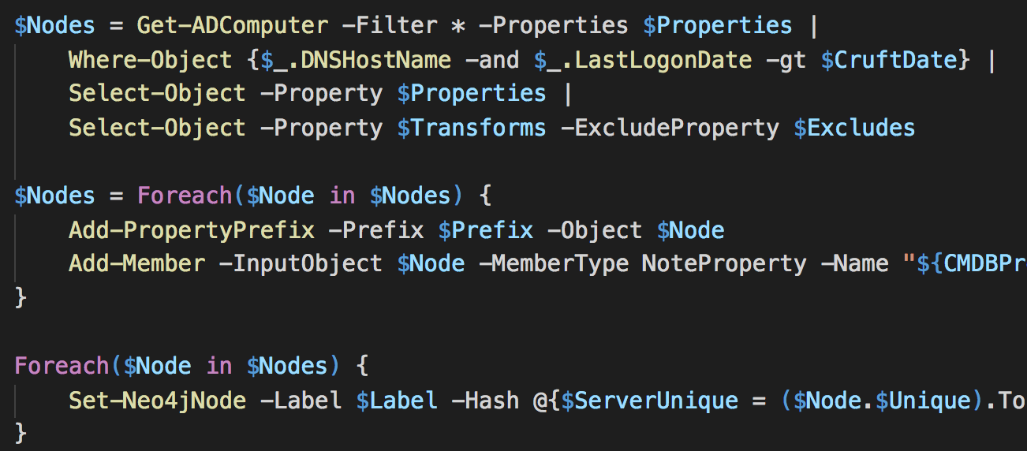
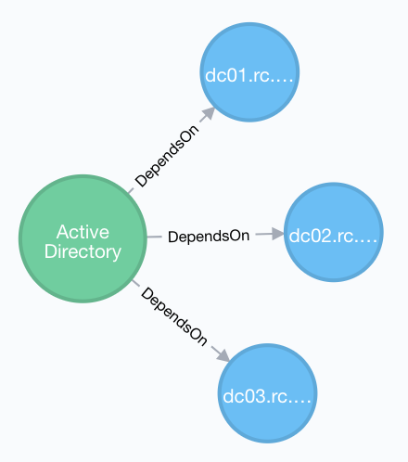
Dots: Code Data Sources
Ingestor Scripts
Runners
Dots!

Slide 22
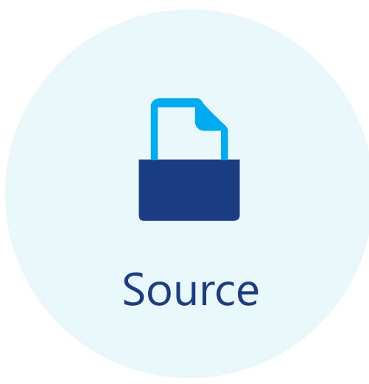
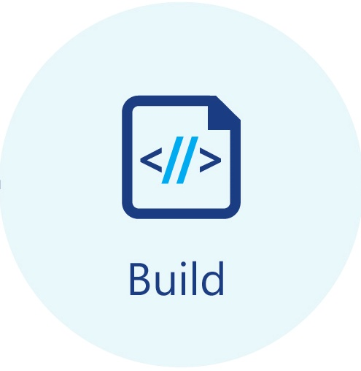

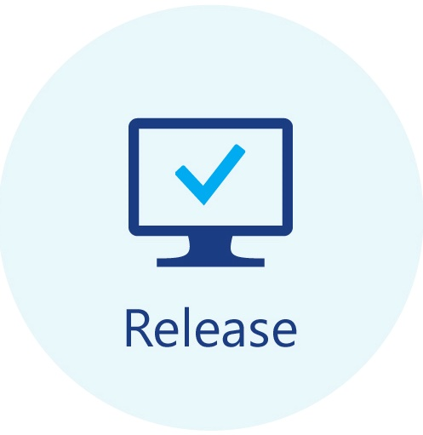










Dots: Execution
Yaml sources:
Code sources:

Slide 23
Questions?

Slide 24
Dots: Demo!

Slide 25
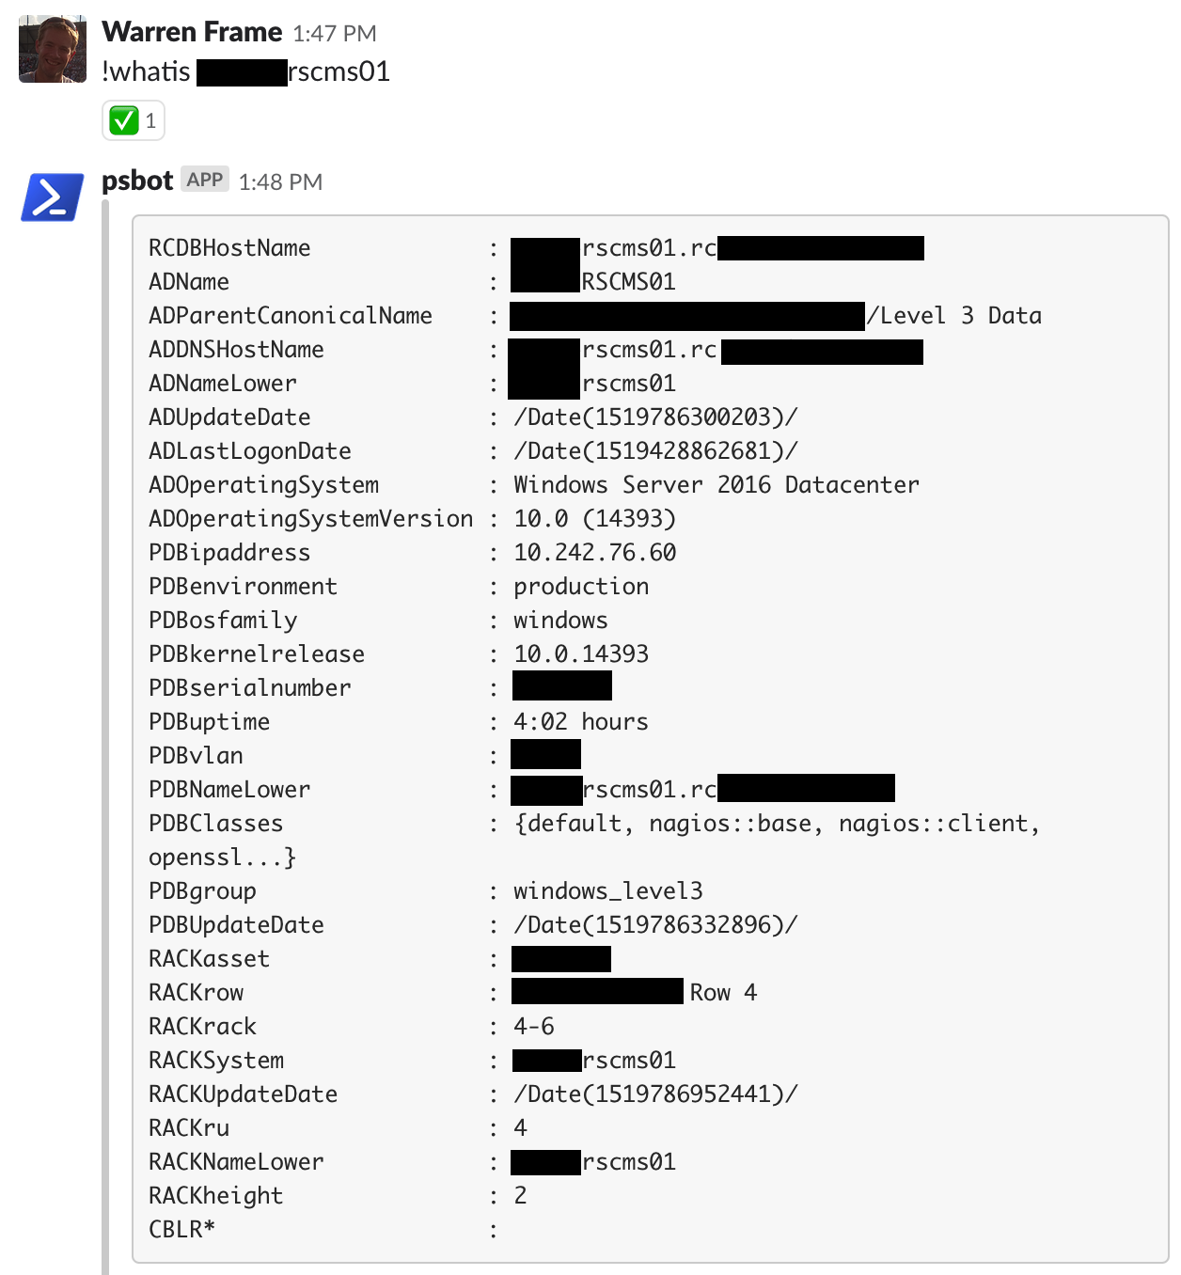
We have a database… Now what?

Slide 26
Questions?
Materials:
Eventually, https://github.com/RamblingCookieMonster/Dots
Current slides, references (tomorrow): http://bit.ly/bospsugmaterials

